Slide 1


Introduction and Hands-On
Generative AI
Hrishikesh Yadav

Slide 2

TABLE OF CONTENTS
1
Understanding LLMs
2
How Does it work
3
Why Generative AI Now
4
Various Application
5
Prompt Tuning
6
Hands-On for Prompt Tuning
7
Introduction to Langchain and Hands-ON for RAG

Slide 3
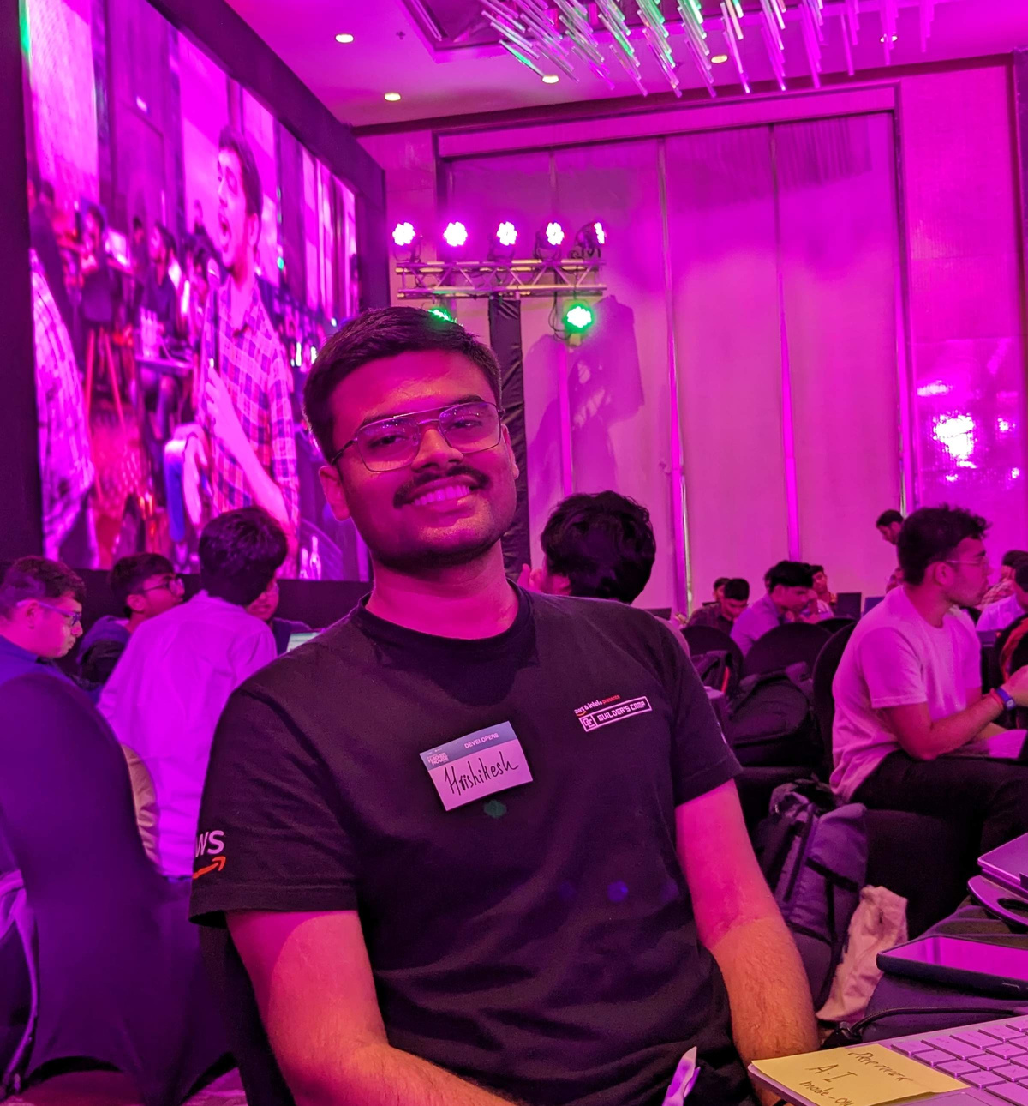
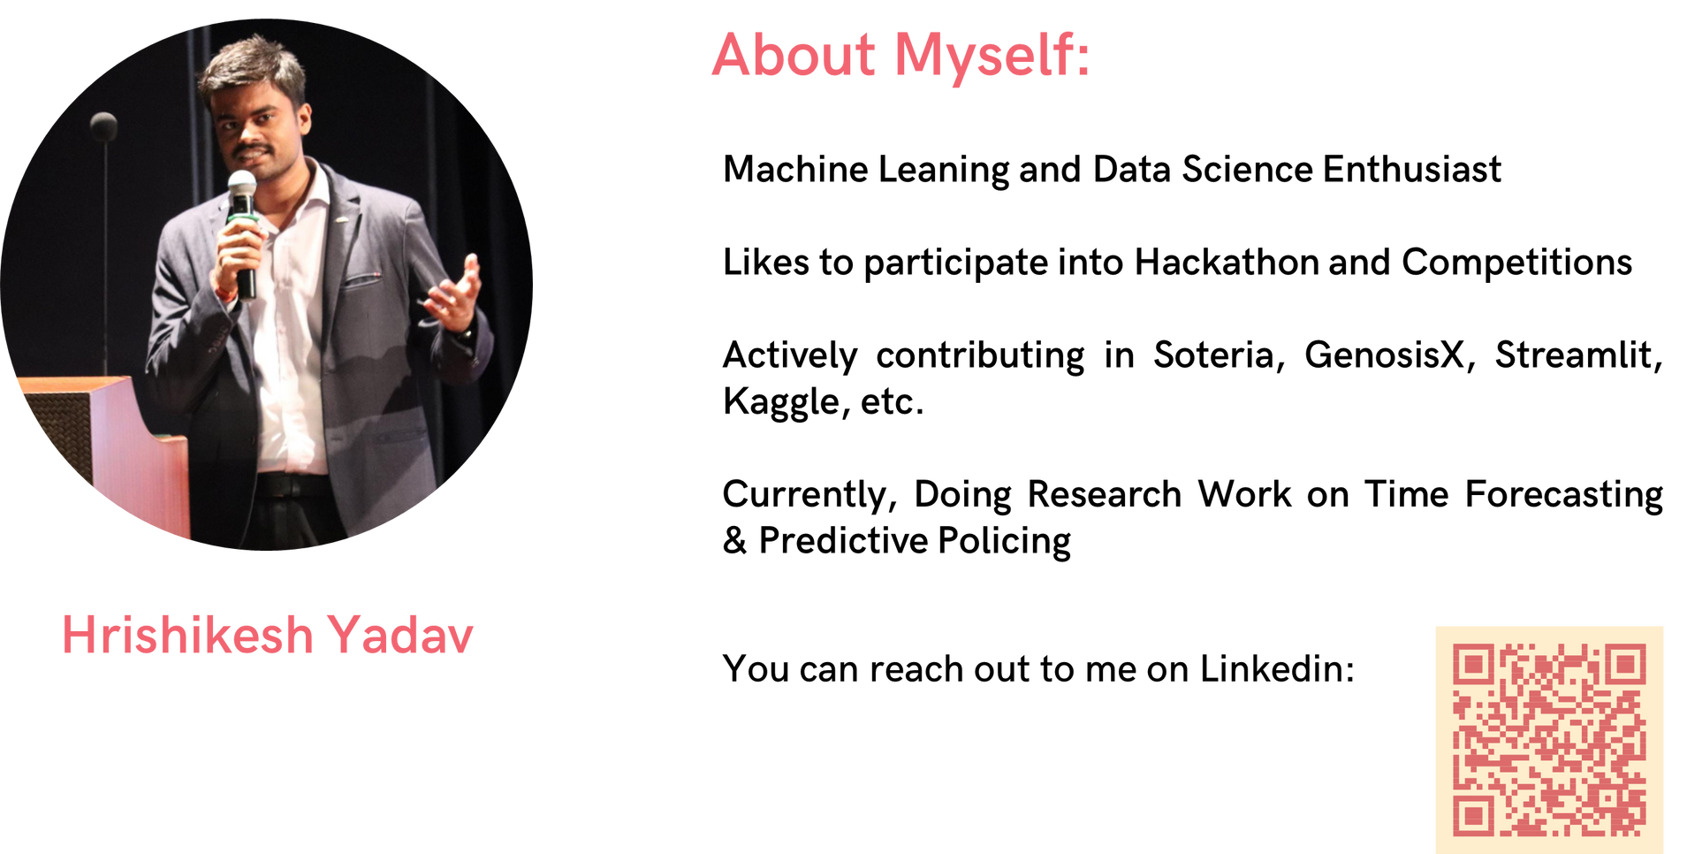

ABOUT
Machine Leaning, Data Science and Applied Generative AI Enthusiast
Likes to participate into Hackathon and Competitions
Actively contributing in Soteria, GenosisX, Streamlit, Kaggle, etc.
Currently, Doing Research Work on Predictive Policing and Applied Generative AI
GDSC TCET VCP 22-23
AI Lead @TCET OpenSource
Community Co-Lead @GenosisX
AI Instructor @RanchoLabs
Student Ambassador @Strealmit

Slide 4

KERAS API PHILOSPHY
Progressive Disclosure of Complexity

Slide 5

Generative AI k aage koi kuch bol sakta hai kya
Generative AI

Slide 6
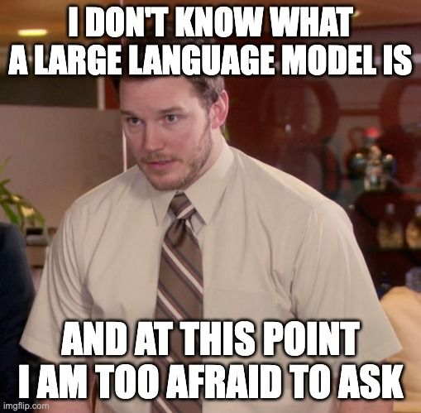
WHAT IS
LLM

Slide 7
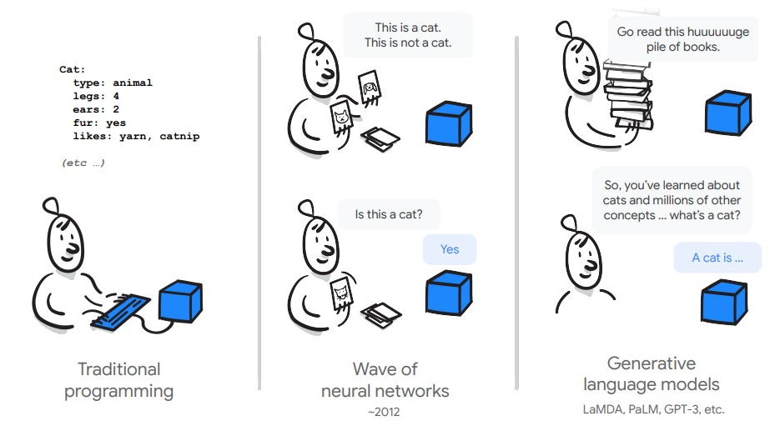
WHAT IS
LLM

Slide 8
WHAT IS
LLM
LLMs are typically trained on datasets large enough to include nearly everything that has been written on the internet.
LLMs can apply their language understanding to tasks they were never explicitly trained.
LLMs are not just for teaching AIs human languages, but for understanding proteins, writing software code, and much more

Slide 9

WHY LLM IS ON BOOM
Changes how we interact with the data
Can find pattern and connections in massive, disparate data corpus

Slide 10

WHY LLM IS ON BOOM
Does not need ML expertise
Does not need to train a model
Need zero training data
Only think about the prompt design

Slide 11
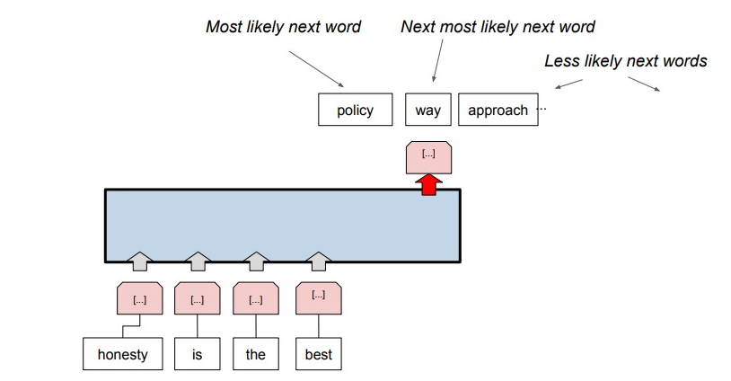
HOW DOES IT WORK

Slide 12
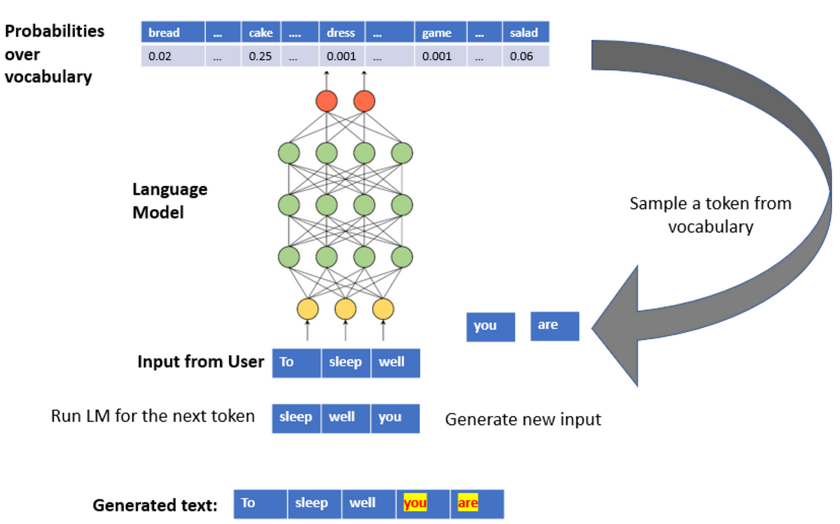
HOW DOES IT WORK
JAYESH

Slide 13
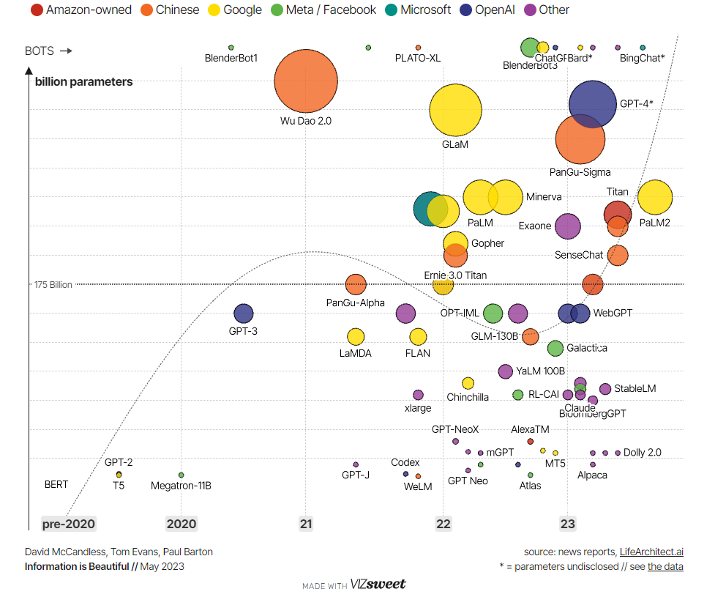
JOURNEY OF
LARGE
LANGUAGE
MODELS

Slide 14
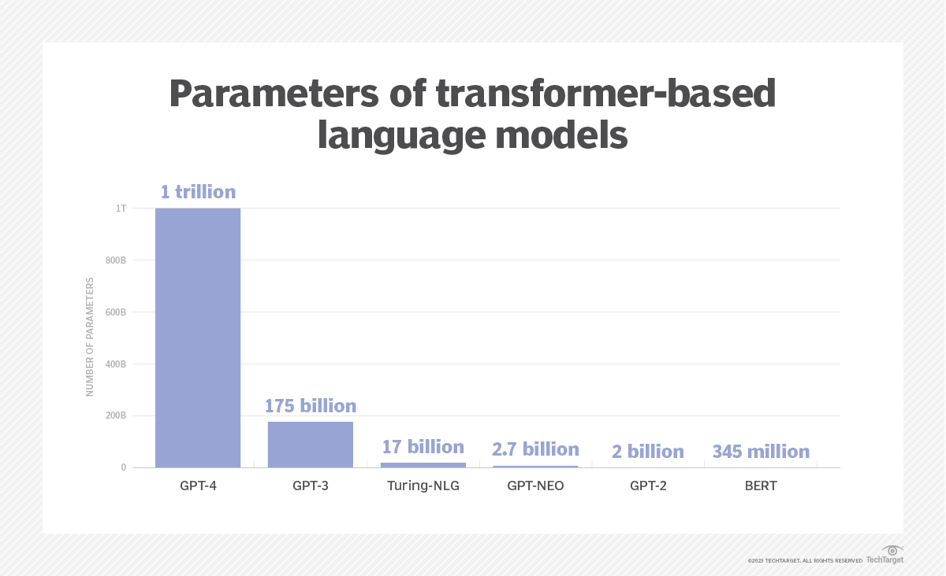

Slide 15




GENERATIVE AI FRAMEWORK

Slide 16
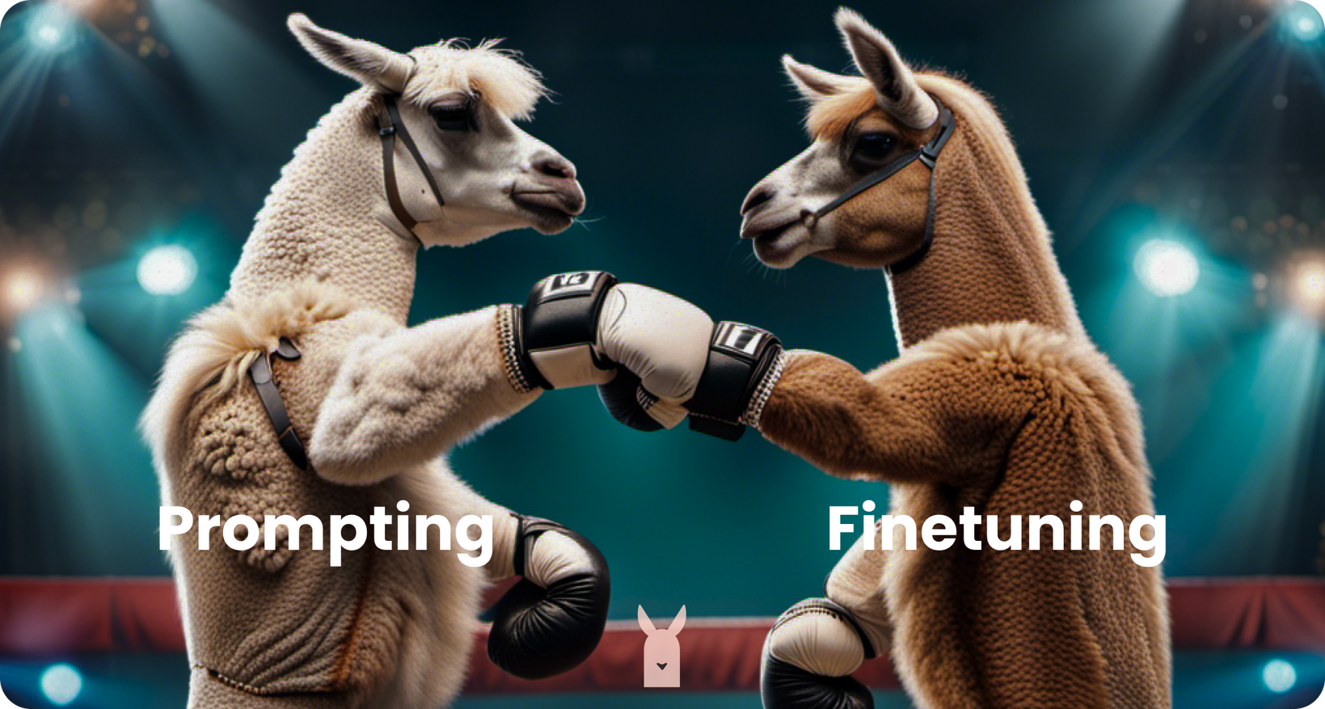
GENERATIVE AI
CREDITS -LAMINI

Slide 17
PROMPT ENGINEERING
Prompt - Text which is provided to the model
Prompt Design - The art of designing the prompt to get the reply which is the desired output

Slide 18
PROMPT ENGINEERING
Input - The sky is full of
Output - [stars(0.6), clouds (0.2), planes(0.002), ...]

Slide 19
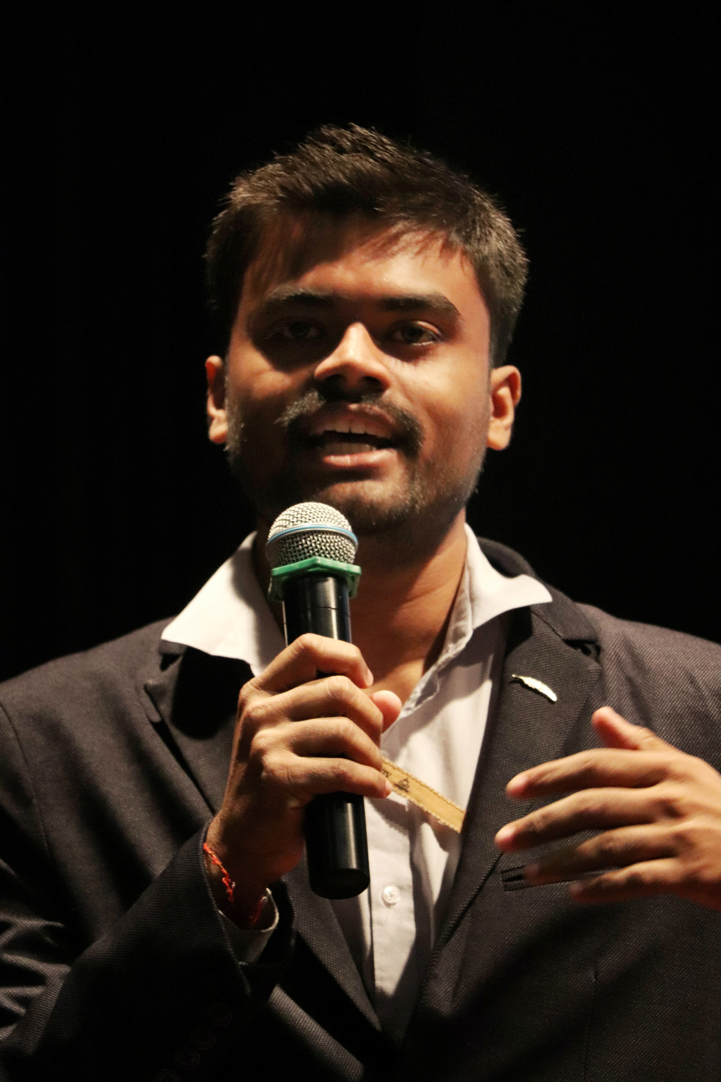
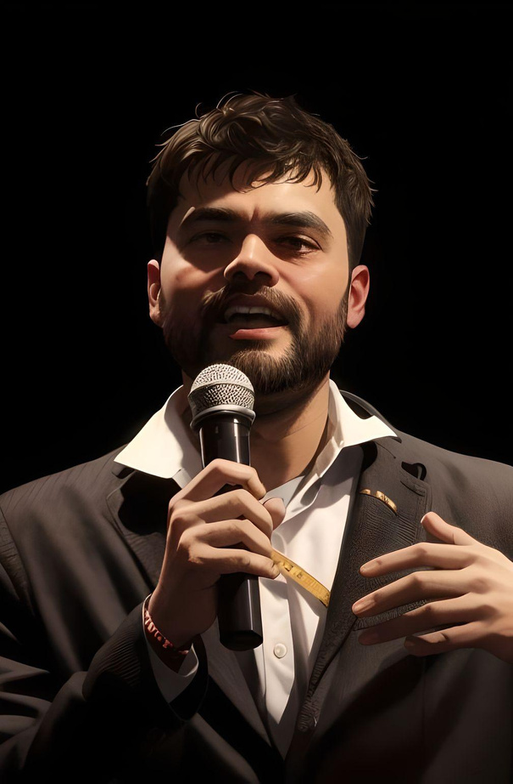

TEMPERATURE TUNING

Slide 20
APPLICATION IN INDUSTRY
Customer Support
Generating product descriptions
Generating Code Snippets from prompt
Entity Extraction from KYC documents
HealthCare Domain Specific Task - Documentation

Slide 21
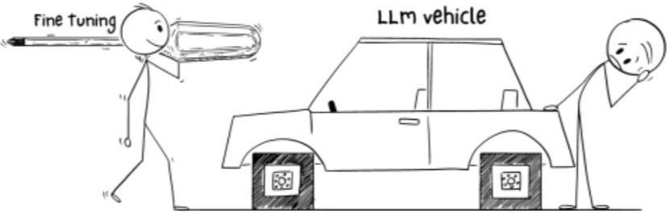
WHY
FINE-TUNING

Slide 22
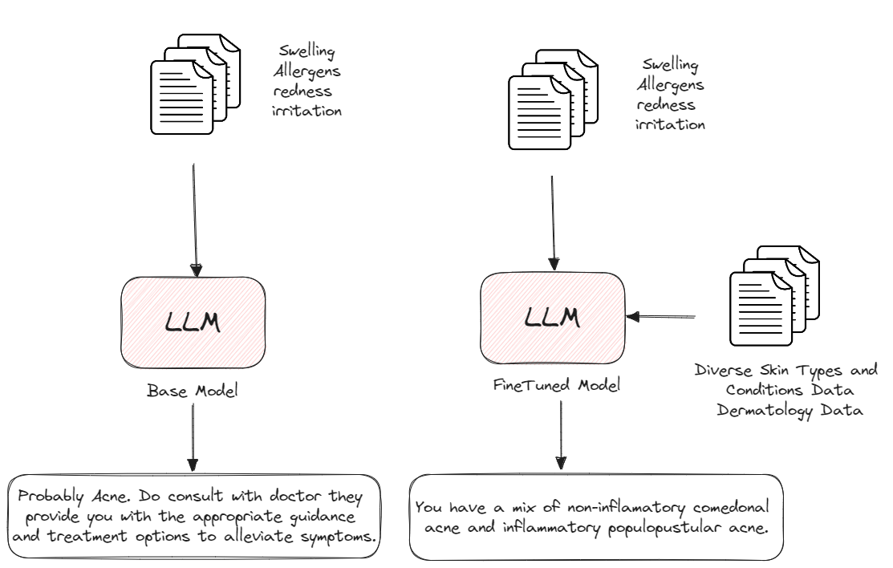
WHY
FINE-TUNING IS NEEDED

Slide 23

WHY
FINE-TUNING IS NEEDED
Domain Specific
Production Usage
Privacy
Stop Hallucination
Reduce unwanted information
Greater Control
Increase Consistency

Slide 24
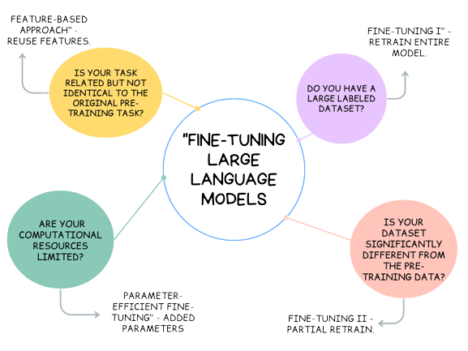
UNDERSTANDING
FINE-TUNING

Slide 25
PROBLEMS WITH FINETUNING
More High Quality of Data
Upfront Compute Cost
Needs Technical Knowledge

Slide 26
EXPANDING CAPABILITIES
LLMs may provide accurate answers to certain questions but struggle with others, often providing random facts from their training data.
This inconsistency stems from the fact that LLMs understand the statistical relationships between words but not their actual meanings.

Slide 27
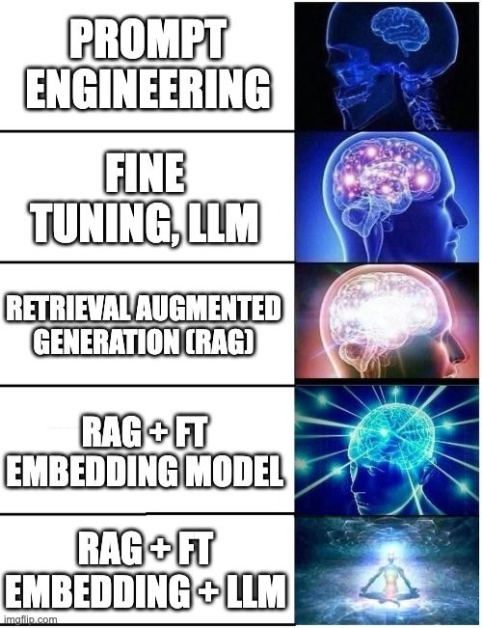
RAG
RAG operates in two main phases: retrieval and content generation
During the retrieval phase, algorithms search for and retrieve relevant snippets of information
In the generative phase, the LLM uses the retrieved information and its internal representation of training data

Slide 28
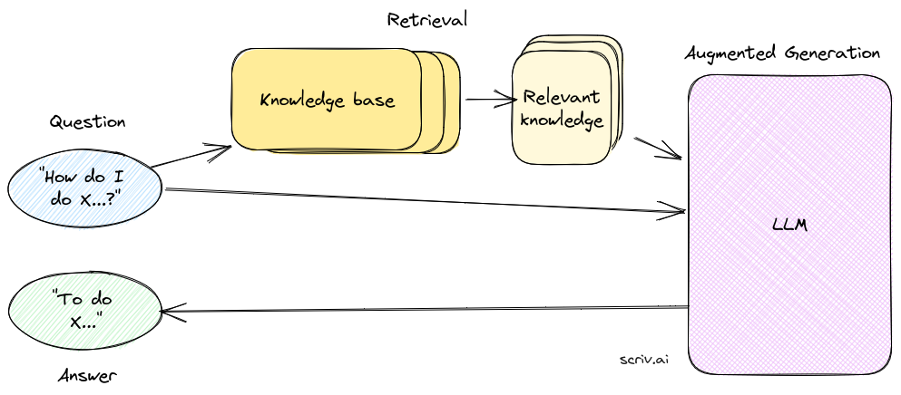
RAG

Slide 29
WHAT IS LANGCHAIN
Langchain simplifies building applications with advanced language models. It occurs as a revolutionary framework that can combine LLM with personalized data sources effectively

Slide 30
KEY FEATURES OF LANGCHAIN
Framework for LLM application
It supports integration or collaboration with various large language models including both open source and proprietary models according to users or organization
Data Source Integration
Customizable Application
Ease in Future Enhancements

Slide 31
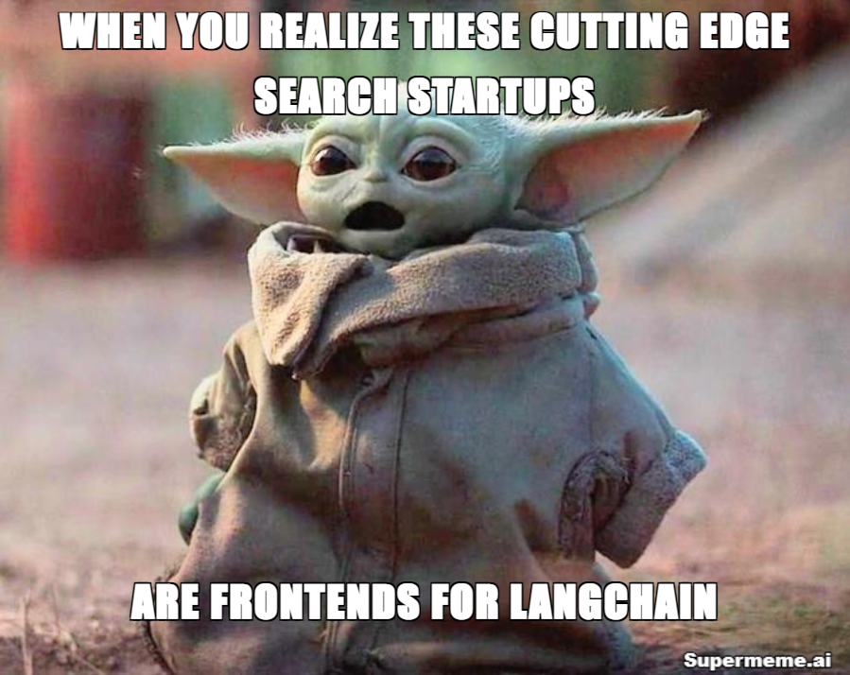
BENEFITS
Cost Saving
Real Time Information
Data Access and Security
Customization and Integration
Potential Use - Chatbot, Personal Assistant, Question & Answering over Docs and Extraction, etc.

Slide 32

RESOURCES AND
URL
Scan the QR

Slide 33
ABOUT
Machine Leaning, Data Science and Applied Generative AI Enthusiast
Likes to participate into Hackathon and Competitions
Actively contributing in Soteria, GenosisX, Streamlit, Kaggle, etc.
Currently, Doing Research Work on Predictive Policing and Applied Generative AI
GDSC TCET VCP 22-23
AI Lead @TCET OpenSource
Community Co-Lead @GenosisX
AI Instructor @RanchoLabs
Student Ambassador @Strealmit

Slide 34
